Slide 1
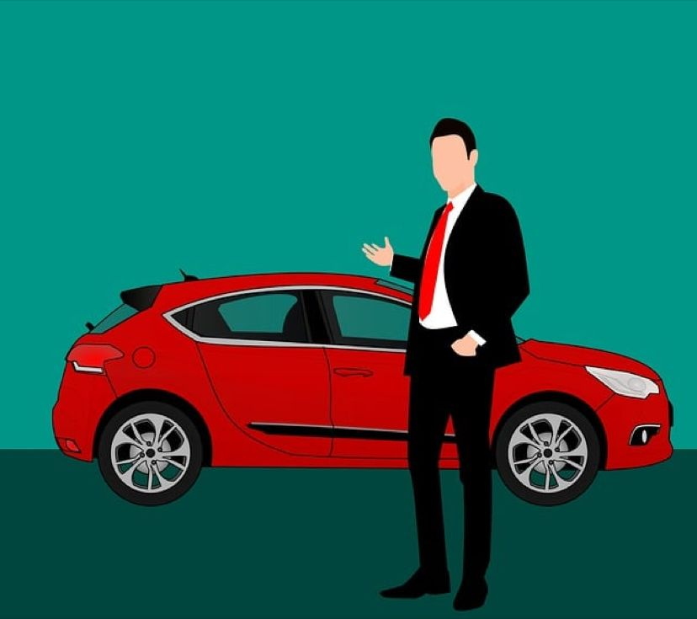
Case Study Steves’s Car showroom
Challenge 1:steel data

Slide 2
INTRODUCTION Steve runs a top end car showroom but his data analyst has just quit and left him without his crucial insights.Can you analyse the following data to prove him with all the answers he requires
STEEL DATA

Slide 3
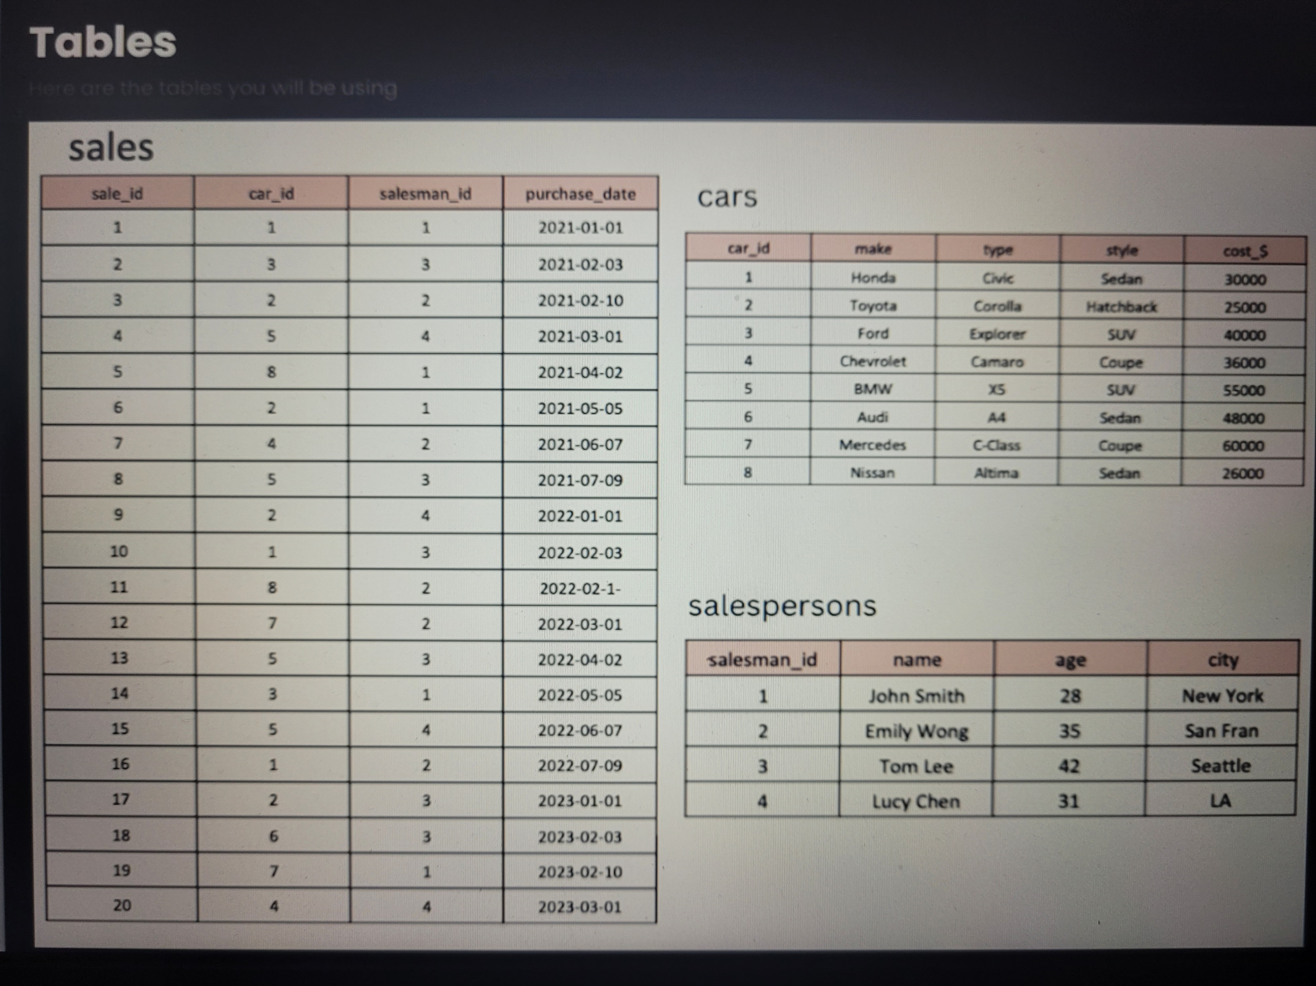
STEEL DATA

Slide 4
Questions 1.What are the details of all cars purchased in the year 2022? 2.What is the total number of cars sold by each salesperson? 3.What is the total revenue generated by each salesperson? 4.Whar are the details of cars sold by each sales person? 5.What is the total revenue generated by each car type? 6.What are the details of the cars sold in the year 2021 by salesperson 'Emily Wong’? 7.What is the total revenue generated by the sales of hatchback cars? 8.What is the total revenue generated by the sales of SUV cars in the year 2022? 9.What is the name and city of the salesperson who sold the most number of cars in the year 2023? 10.What is the name and age of the salesperson who generated the highest revenue in the year 2022?
STEEL DATA

Slide 5
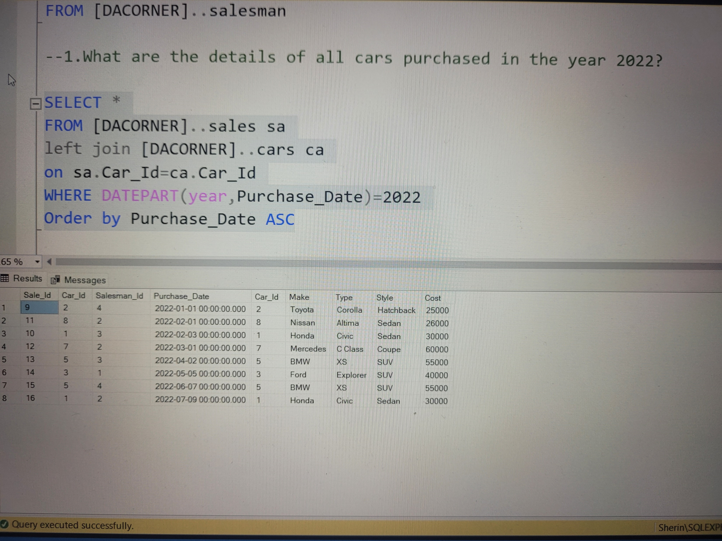
1.What are the details of all cars purchased in the year 2022?
STEEL DATA

Slide 6
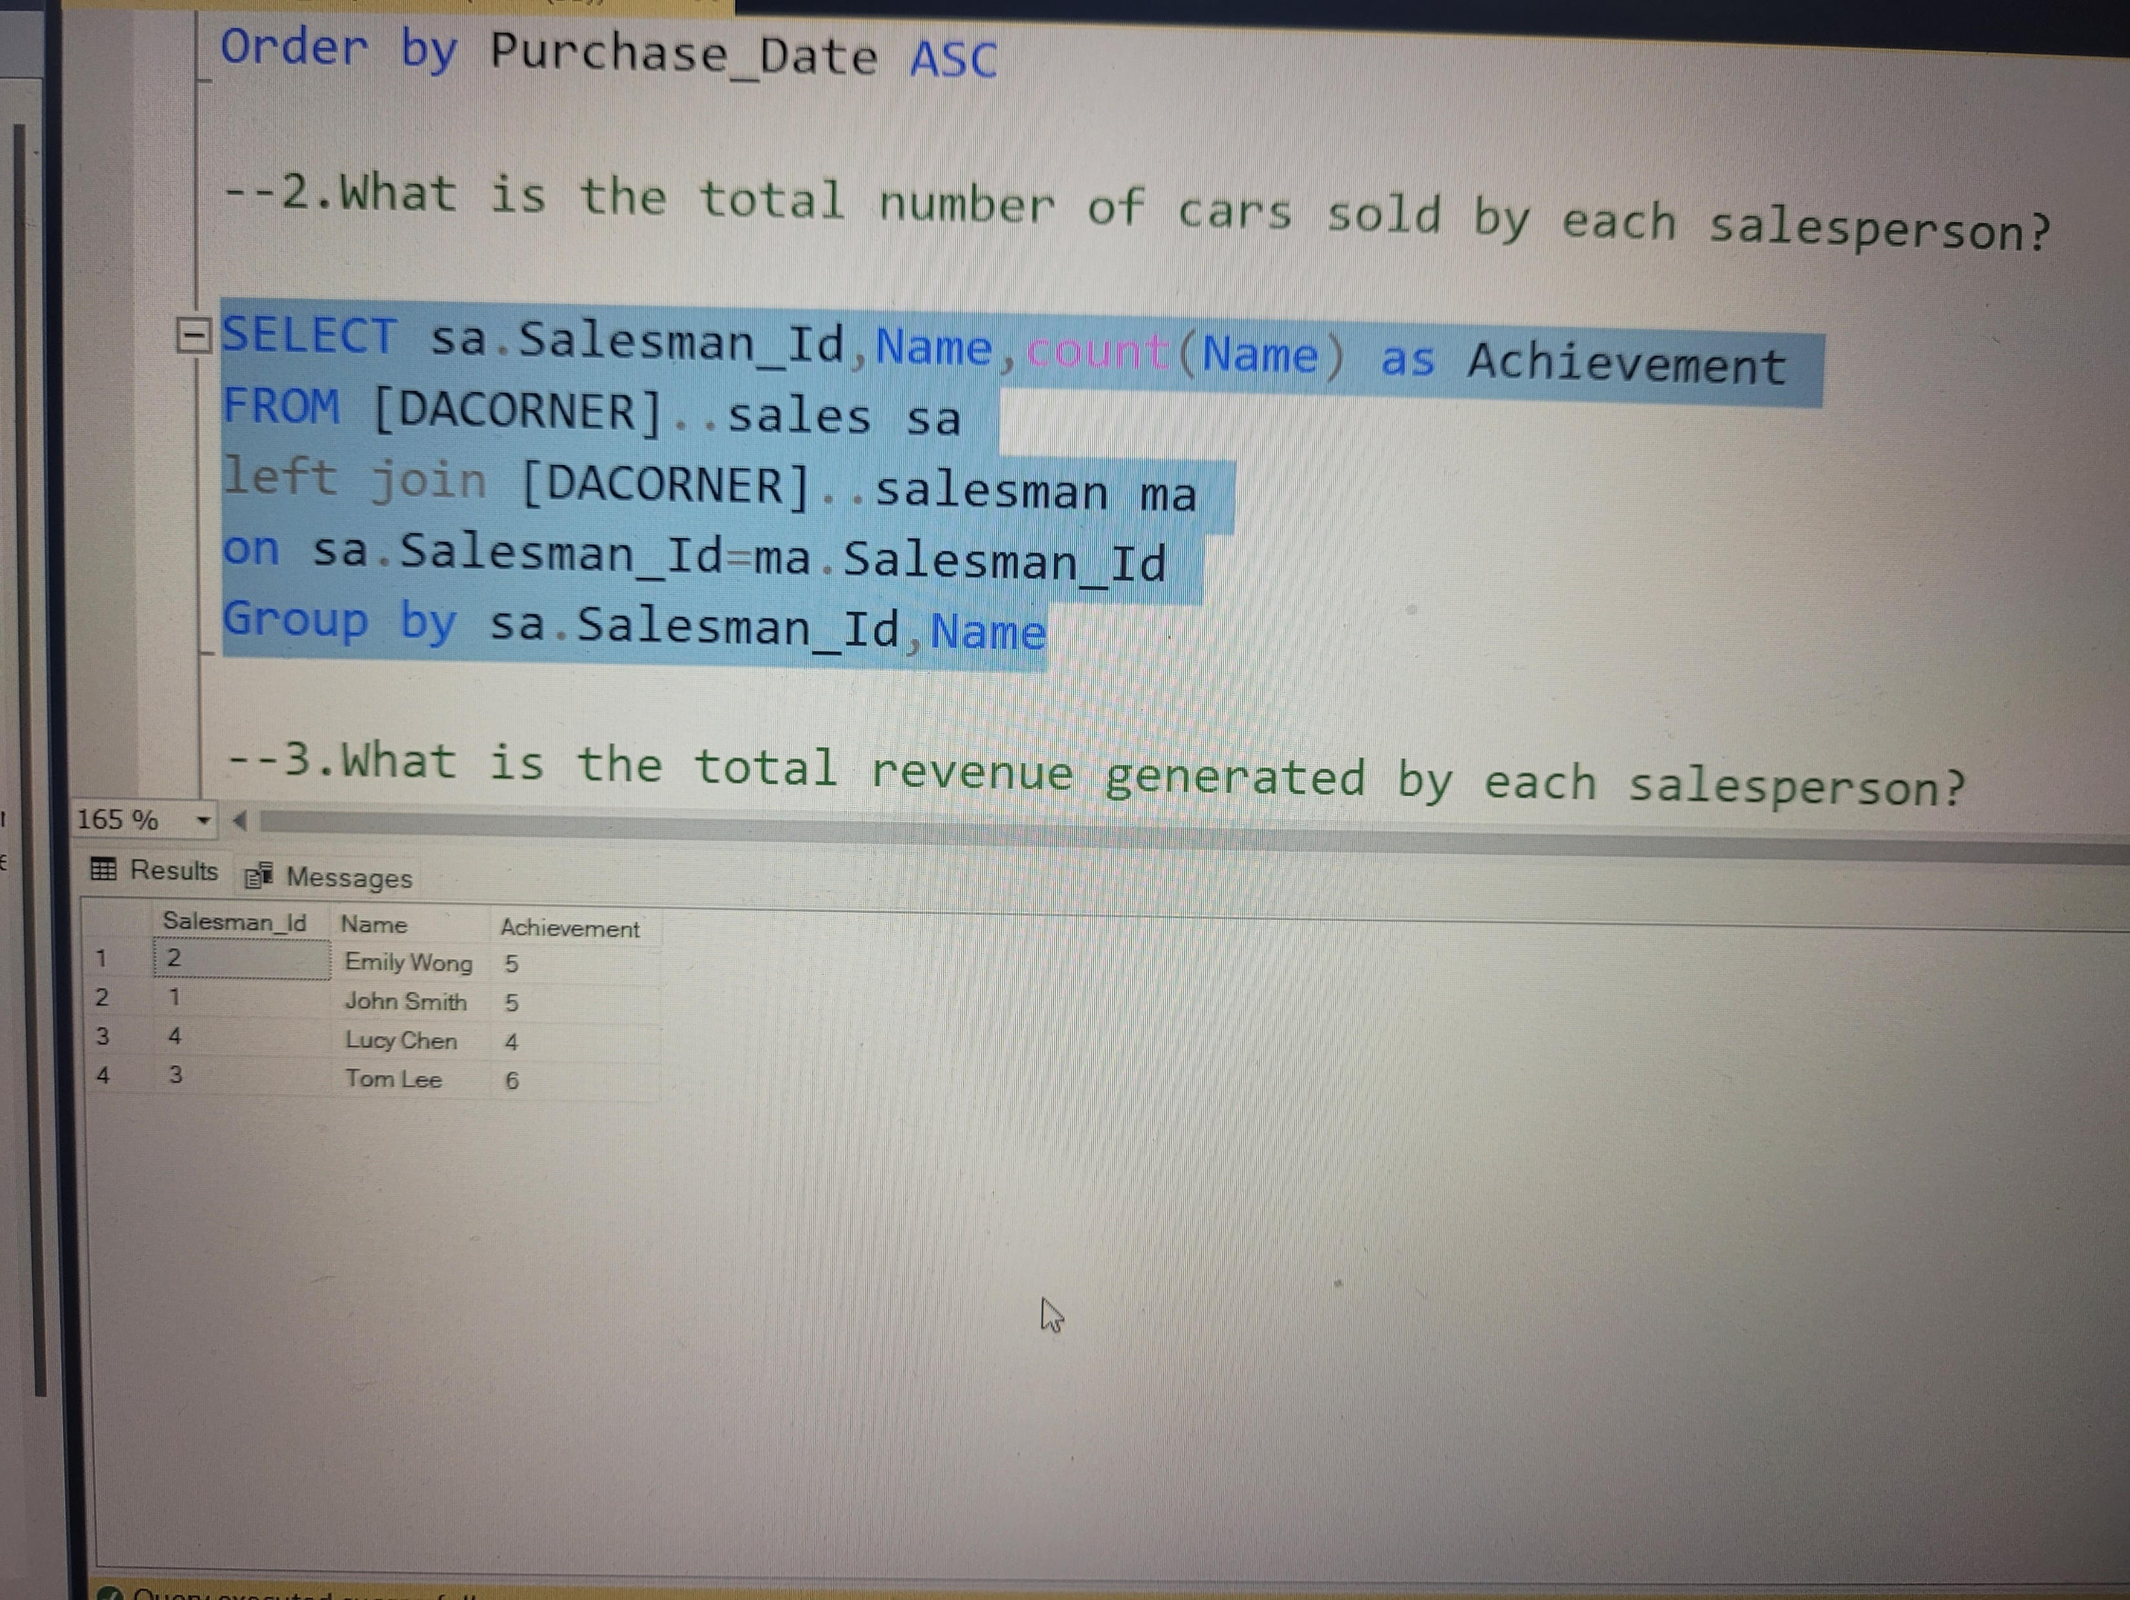
2.What is the total number of cars sold by each salesperson?
STEEL DATA

Slide 7
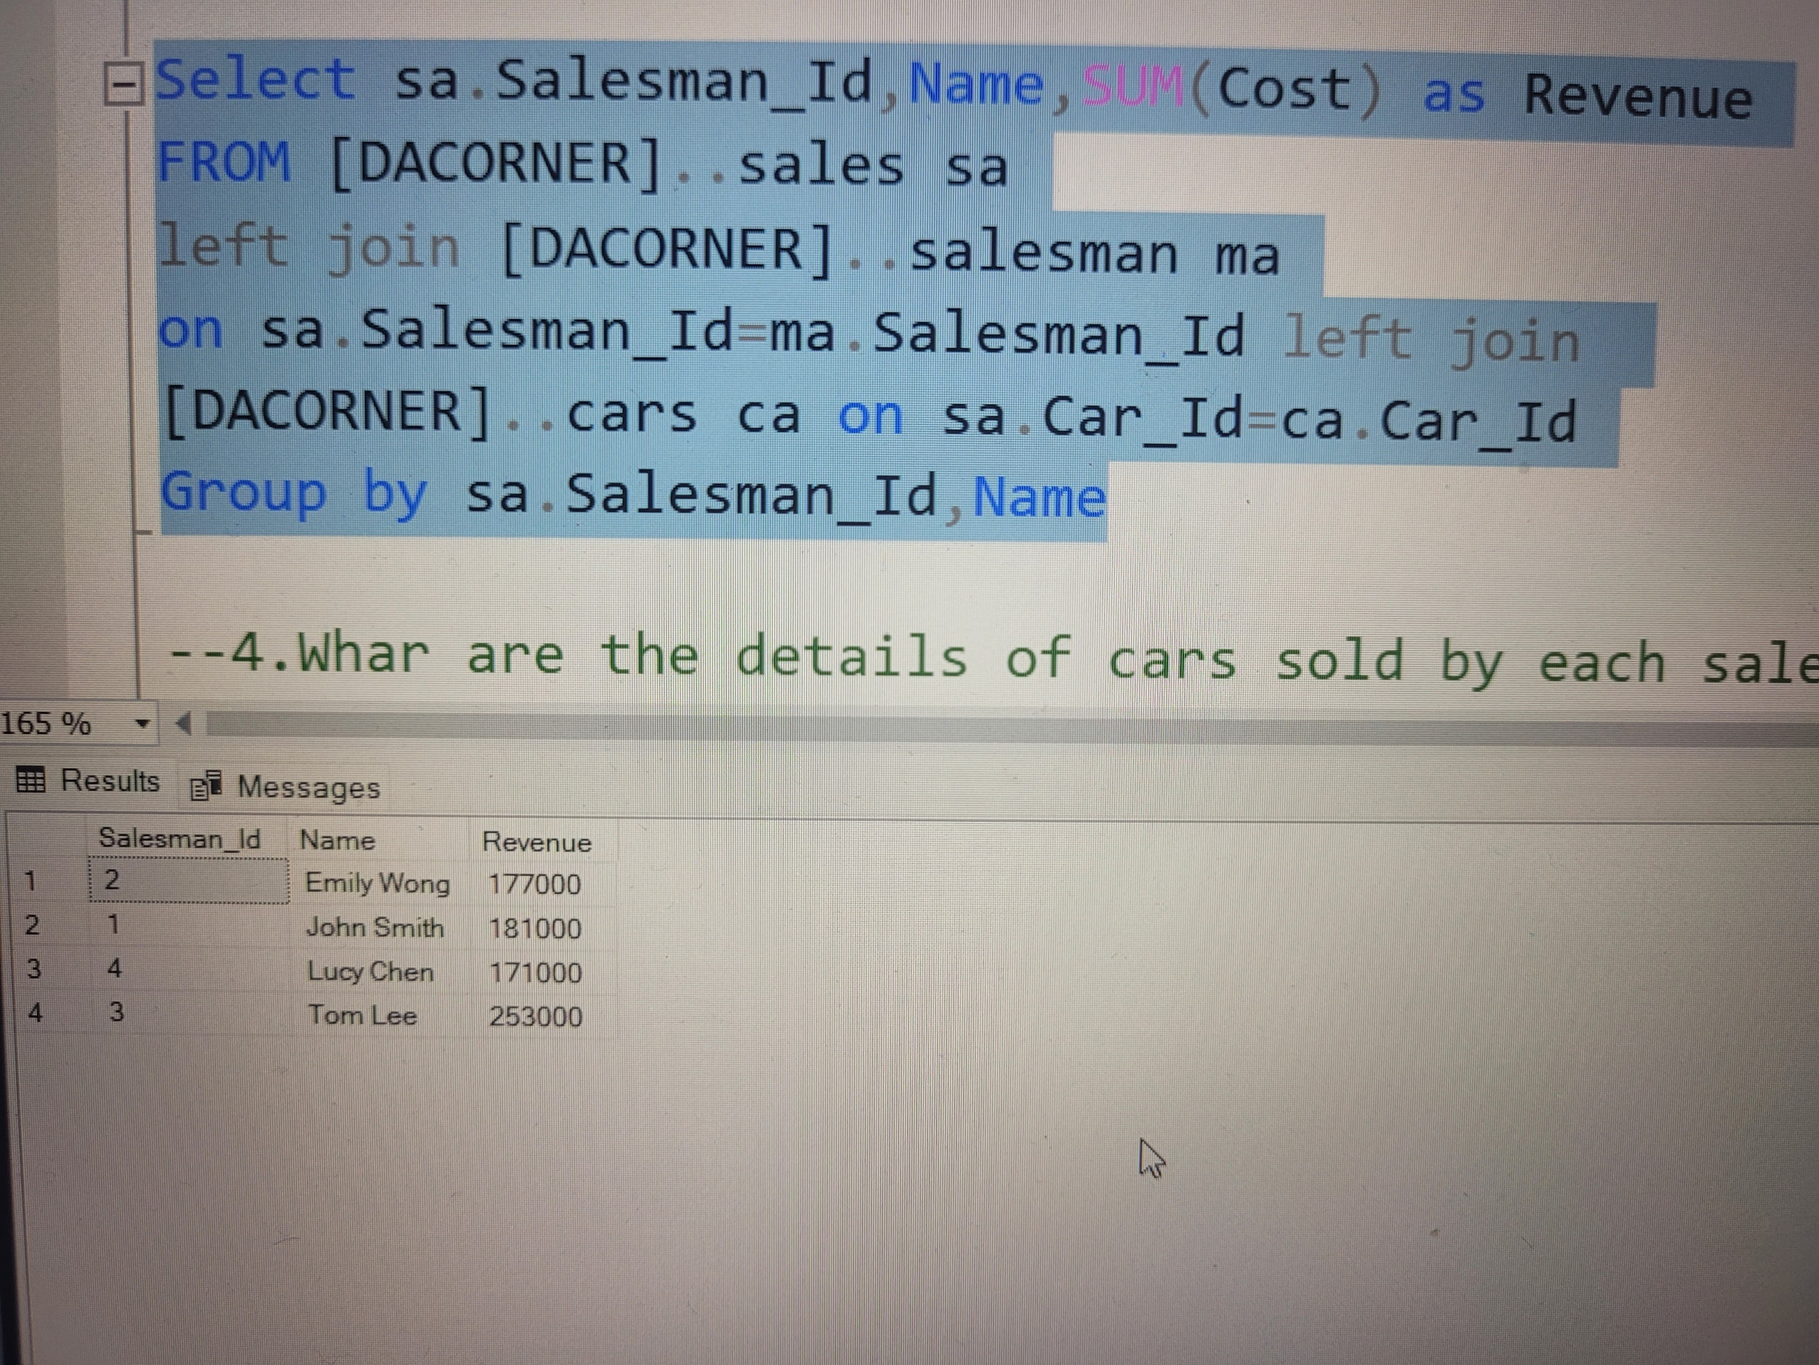
3.What is the total revenue generated by each salesperson?
STEEL DATA

Slide 8
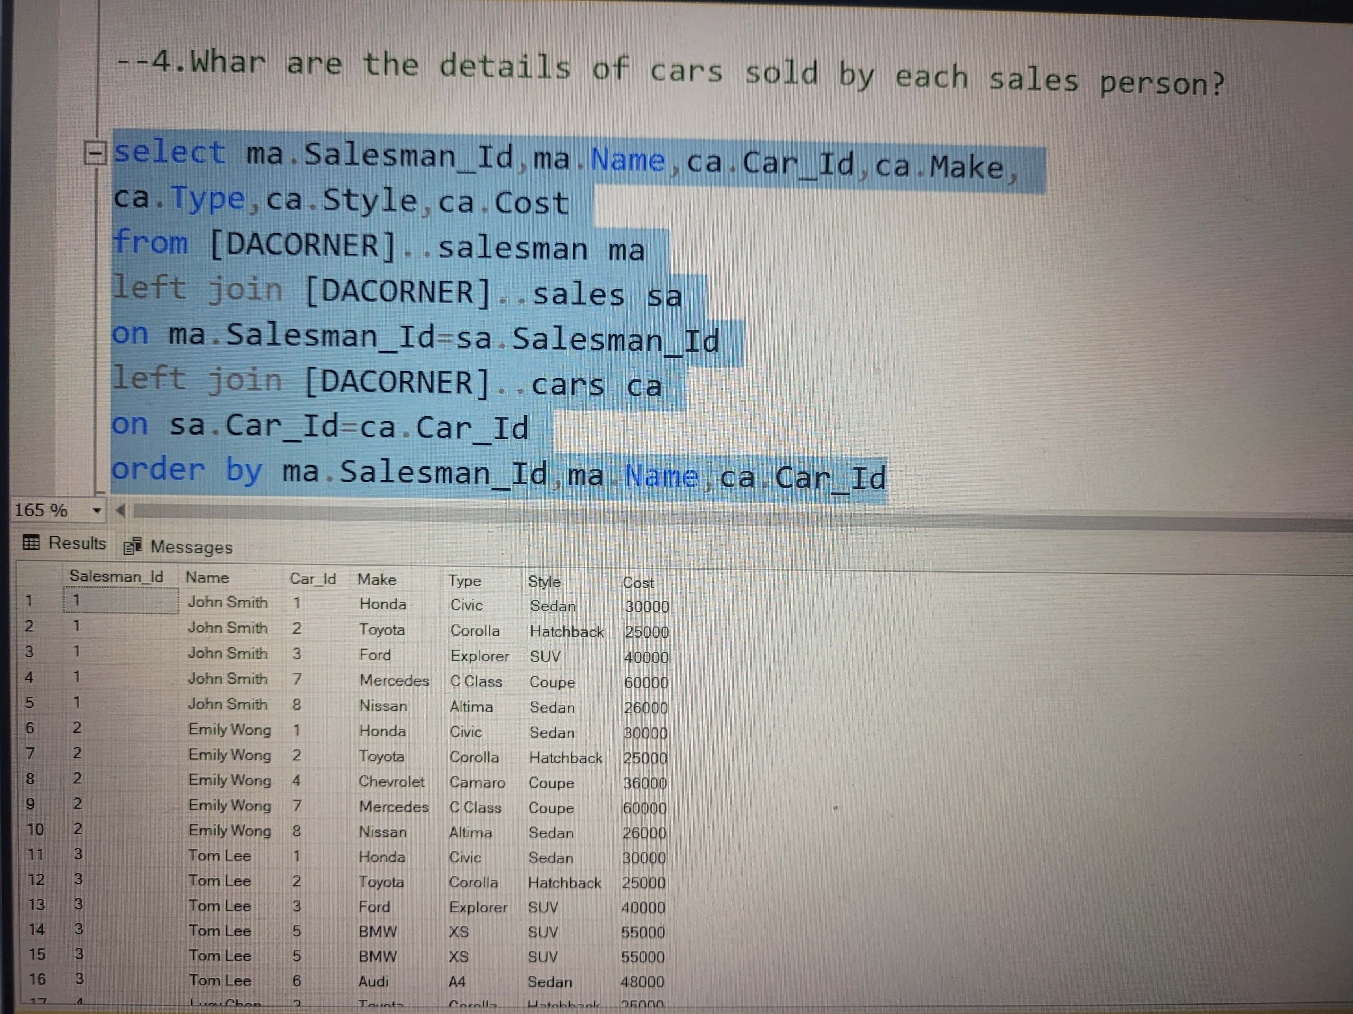
4.Whar are the details of cars sold by each sales person?
STEEL DATA

Slide 9
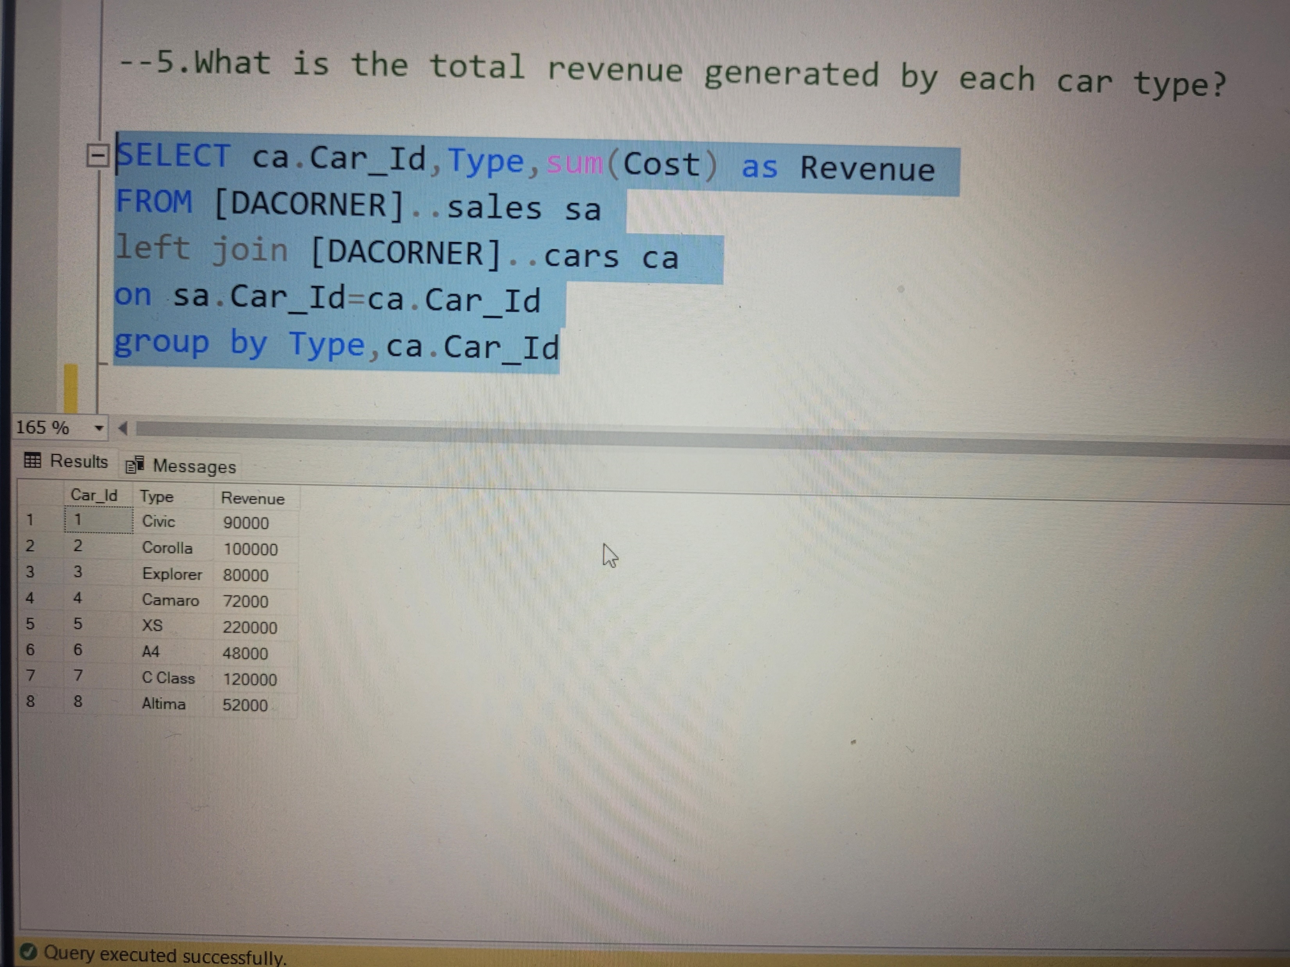
5.What is the total revenue generated by each car type?
STEEL DATA

Slide 10
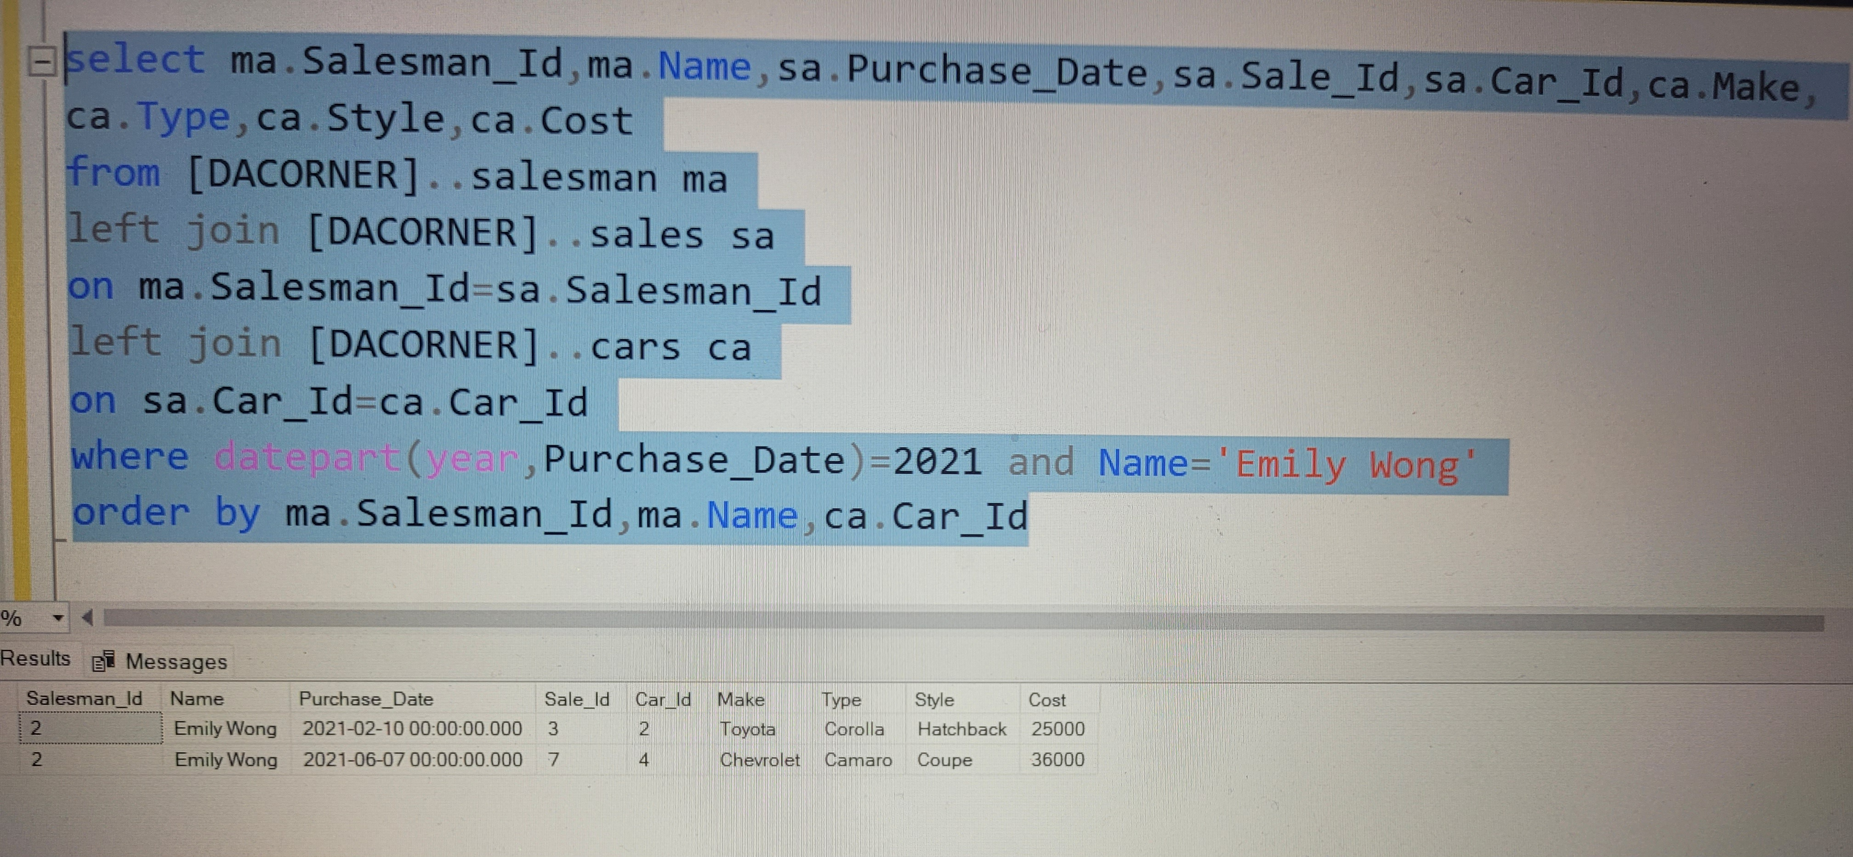
6.What are the details of the cars sold in the year 2021 by salesperson 'Emily Wong’?
STEEL DATA

Slide 11
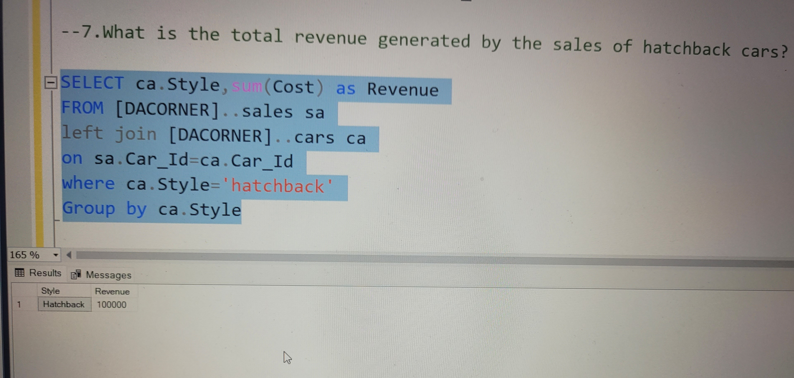
7.What is the total revenue generated by the sales of hatchback cars?
STEEL DATA

Slide 12
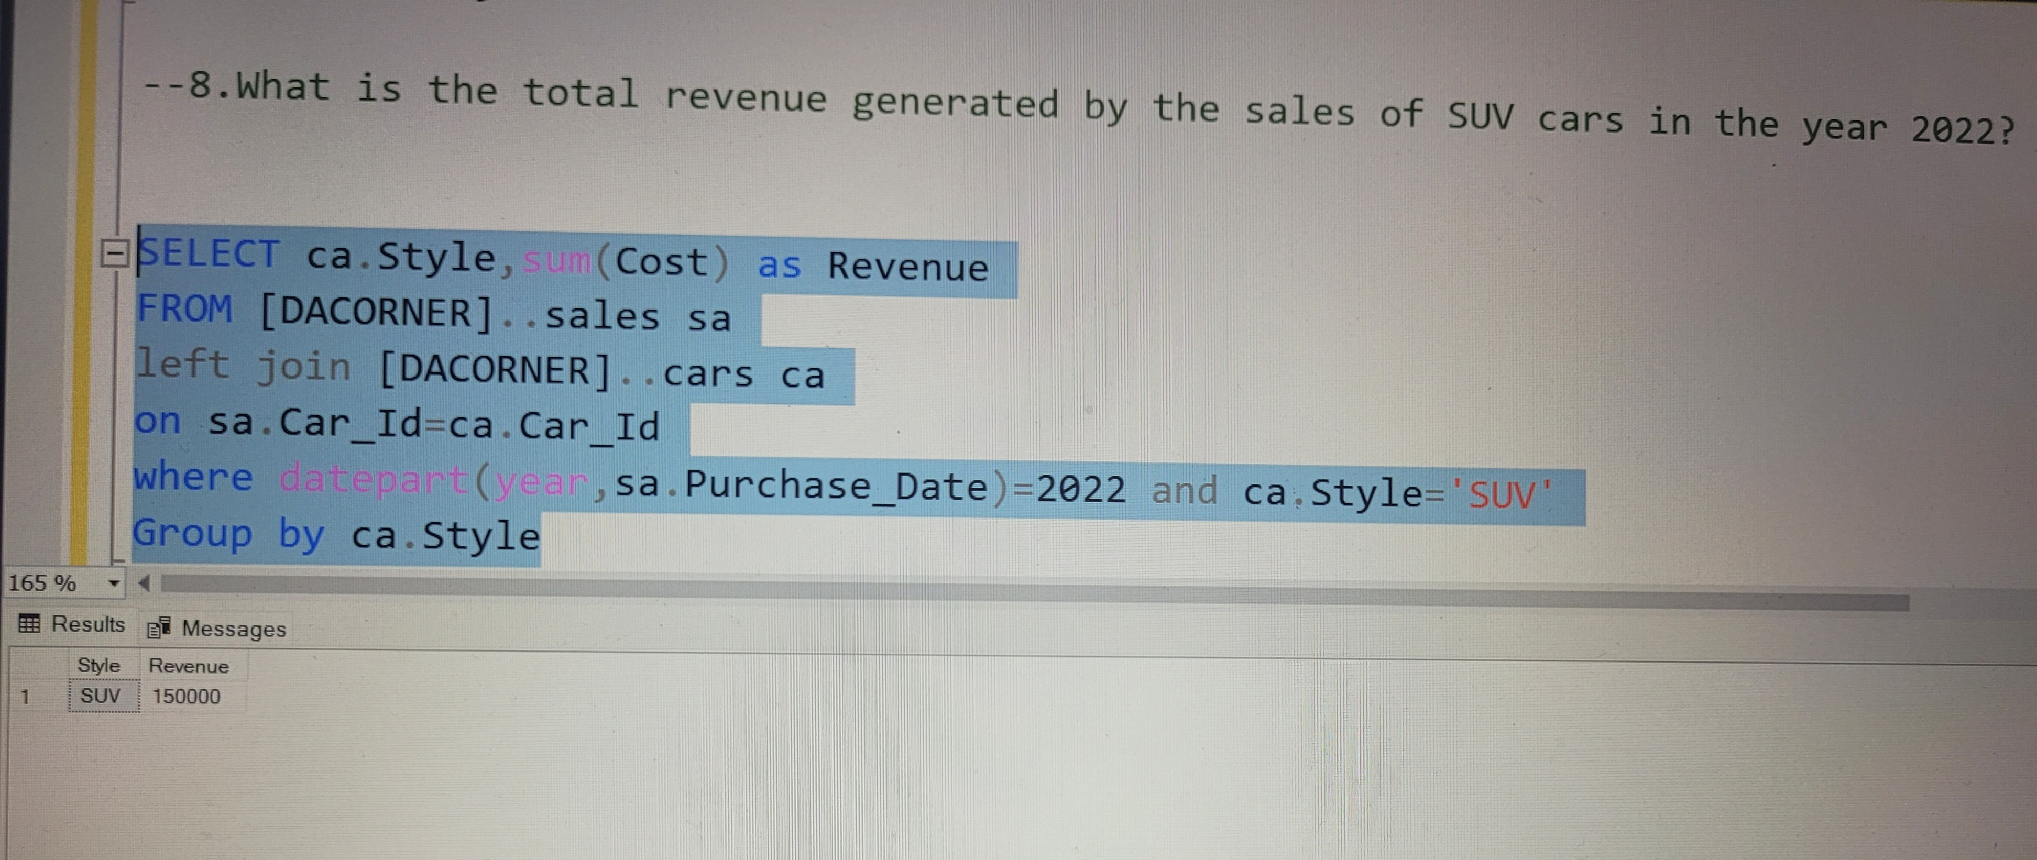
8.What is the total revenue generated by the sales of SUV cars in the year 2022?
STEEL DATA

Slide 13
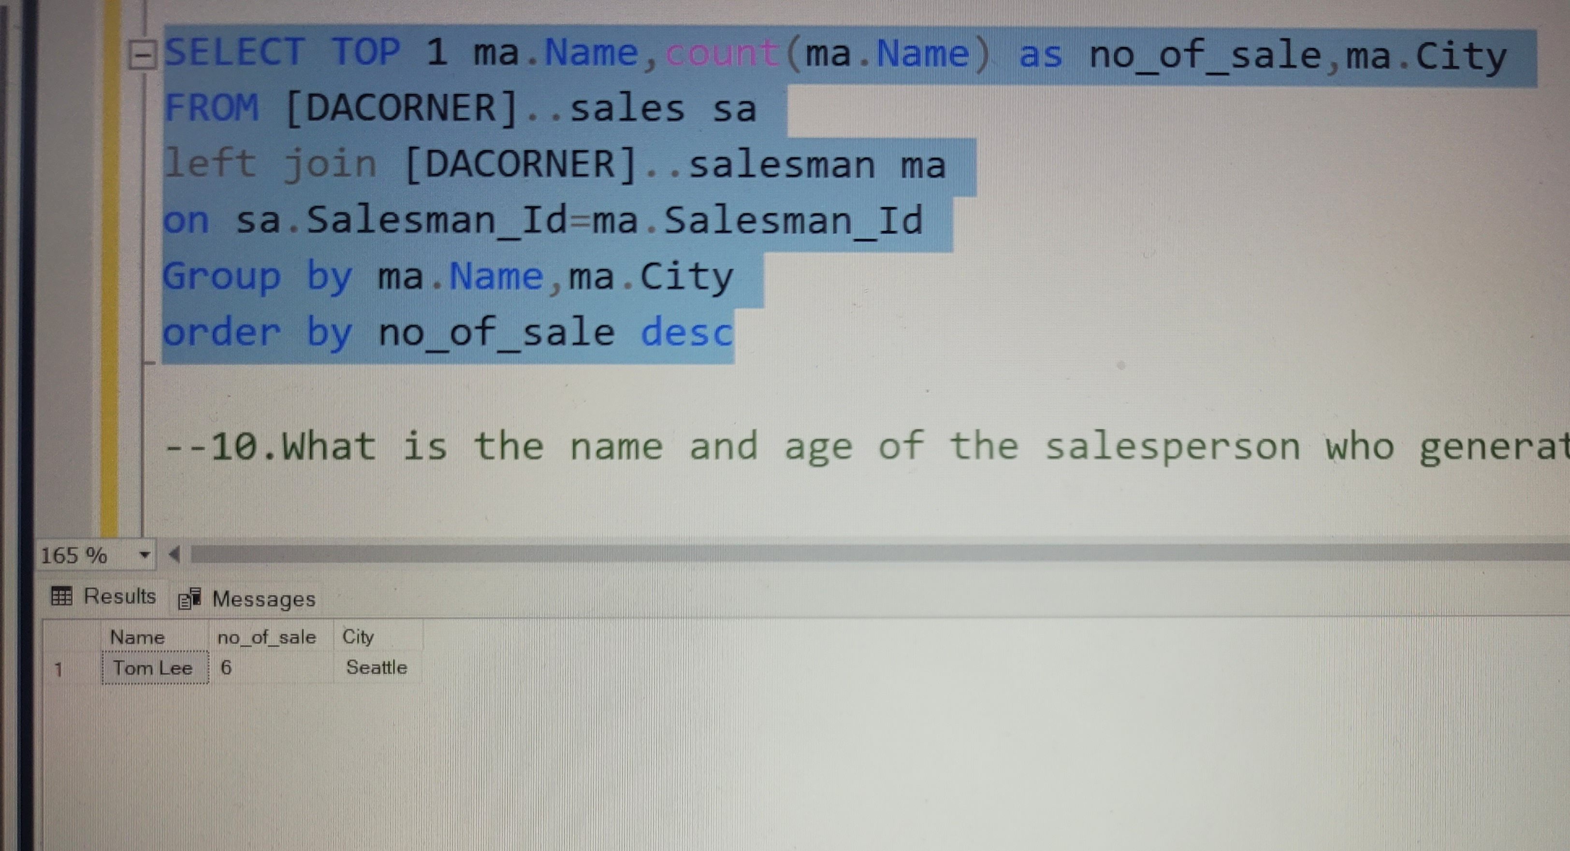
9.What is the name and city of the salesperson who sold the most number of cars in the year 2023?
STEEL DATA

Slide 14
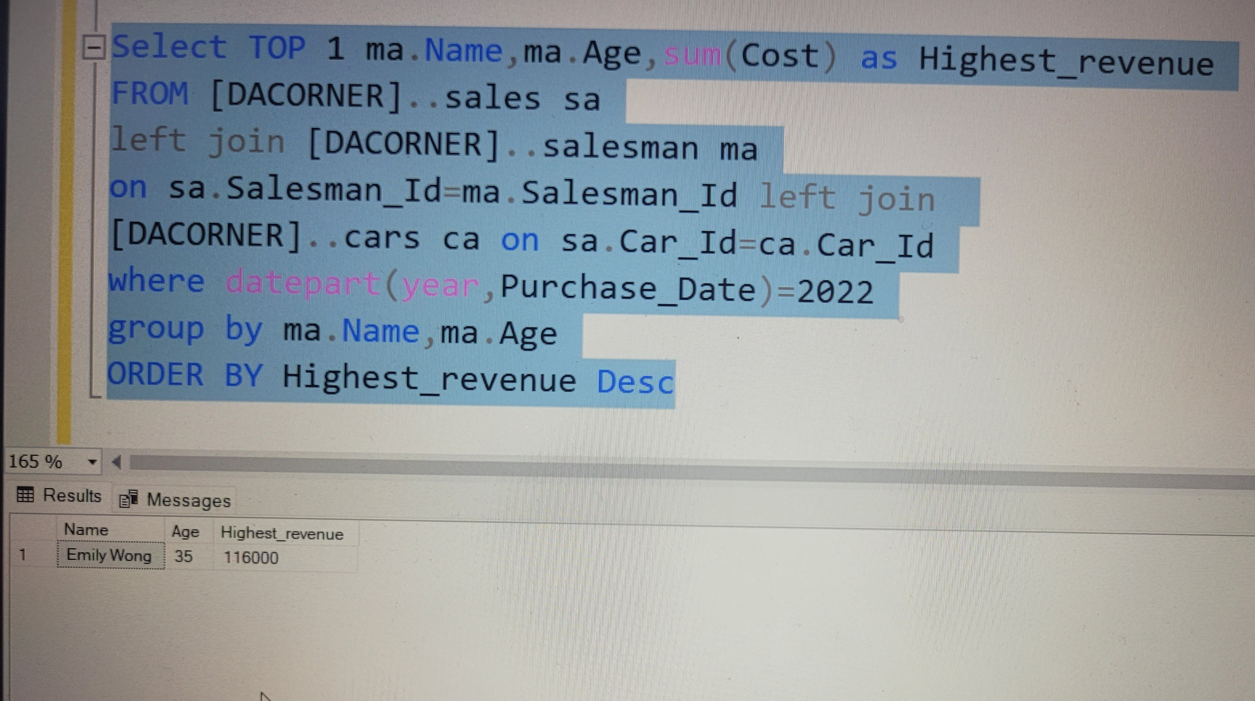
10.What is the name and age of the salesperson who generated the highest revenue in the year 2022?
STEEL DATA

Slide 15
THANK YOU

